Slide 1
RPM Forecast Modeling Project
Forecasting Project
Notes:
Kevin

Slide 2
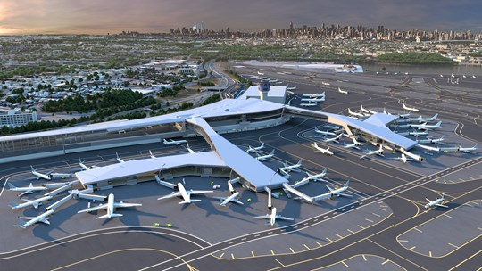
Agenda
Business Relevance
Dataset Review Summary
Time Series Evaluation
Modeling Summary
Recommended Business Actions
Closing
Notes:
Kevin

Slide 3
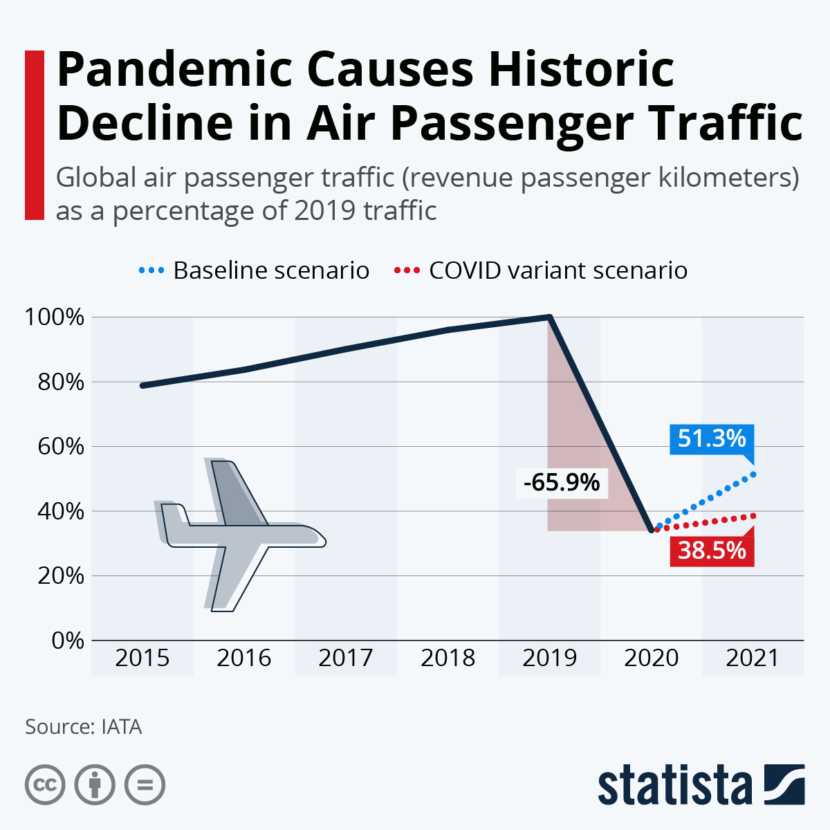
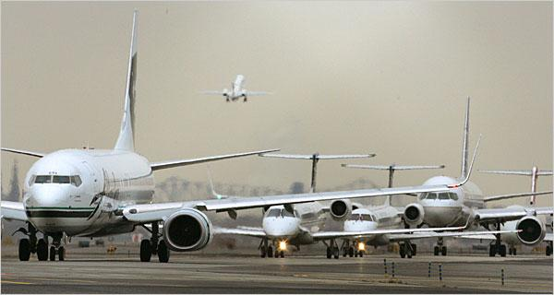
Business Relevance
Aviation Industry - Major global transportation resource
Large economic footprint and supply chain
Complex infrastructure
Highly skilled workforce
Hit hard by pandemic with uncertain future
Why Forecast?
Airports:
Should airports to plan to expansion or renovation?
How will this affect financial planning and staffing?
Airlines:
Should airlines increase the size of their airplanes? Buy additionally airplanes? Sell off airplanes?
How will financial plans be affected?
What route optimizations can be made to meet future demand?
What insights can be gained for ticket pricing strategy?
Notes:
Kevin

Slide 4
Dataset Overview
Highlights:
Monthly U.S. airline traffic data from 2003 to 2023
Source: U.S. Department of Transportation’s (DOT), Bureau of Transportation Statistics
Data Cleaning in Python:
Null value checks
Data type corrections
Date / time formatting
Primary Variable:
Revenue Passenger Miles (RPM)
Measures demand for air transport.
RPM = Number of revenue passengers * Total distance traveled.
Additional Variables:
Pax - Total passengers
Flt - Total flights
ASM - Available seat miles (empty seats / miles traveled)
LF - Load factor (% capacity of planes)
Dataset contains the information needed to answer business questions and cleaned for SAS import
Notes:
Andrea
Highlights: Mention that data has split by Domestic & International
Primary Variable: Mention that RPM can be called airline “traffic.”

Slide 5
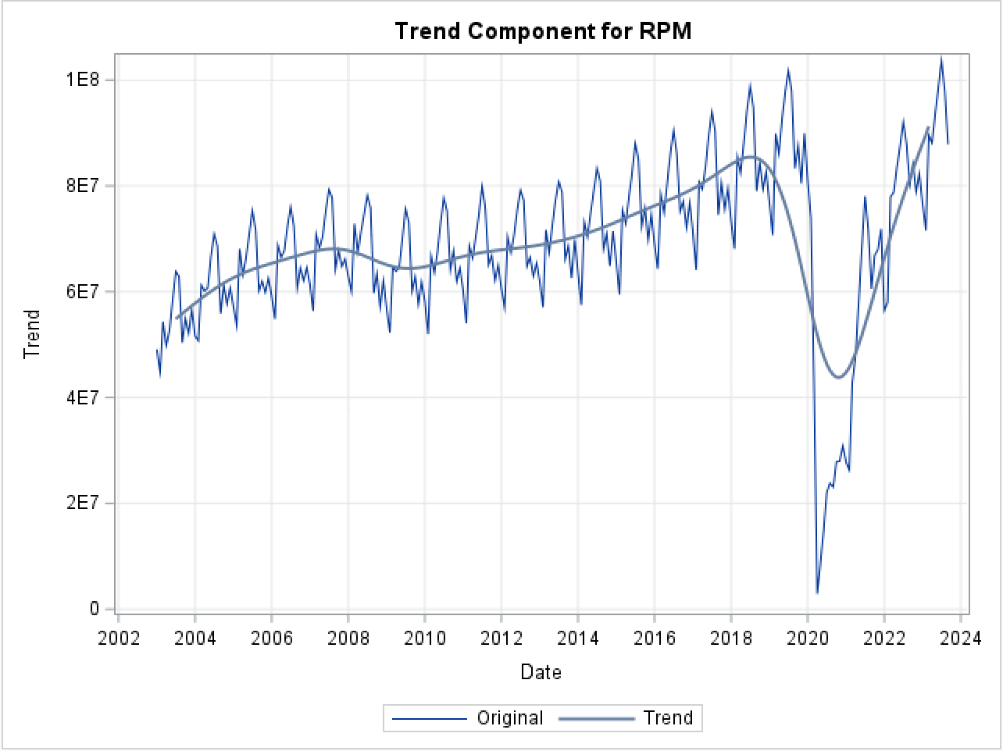
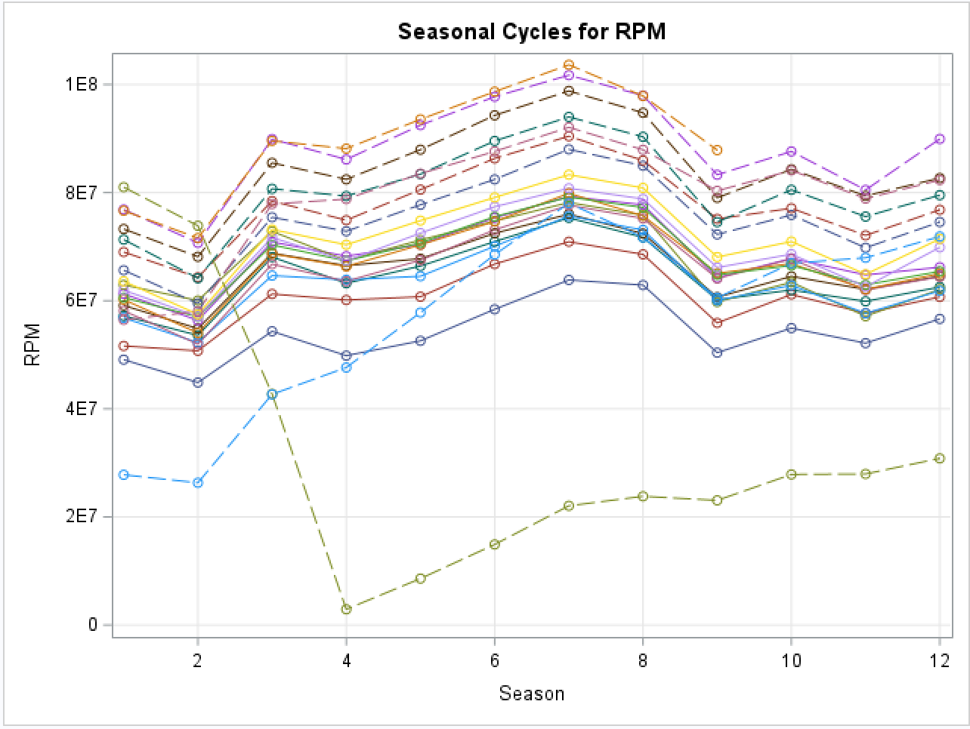
Time Series Exploration
Data has both a trend and seasonality
Highest RPM in July, Lowest RPM in February
General upward trend 2003-2019
Pandemic caused irregularity in 2020-2021
Data has both trend and additive seasonality, with irregularity during pandemic
Notes:
Andrea

Slide 6
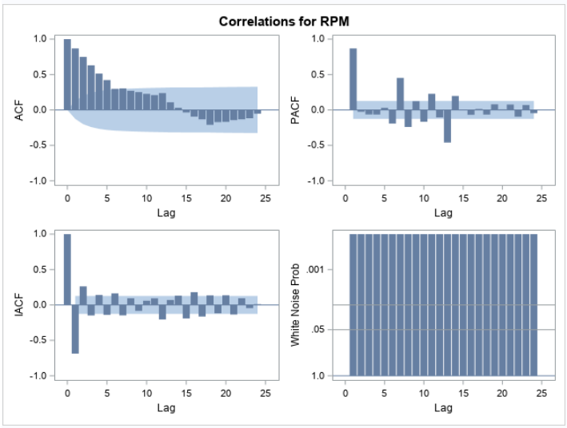
Time Series Exploration cont.
Initial Correlation Data Insights
In ACF, there is significant autocorrelation of errors till lag 6.
PACF shows lag 1 effect.
There is no white noise.
Parameters understood for the next modeling step
Notes:
Andrea
ACF: autocorrelation present
PACF: values at lag 1 are strongly correlated with the values at the preceding time point
White Noise: reject the null, series contains systematic variation that can be used to forecast.

Slide 7
Modeling Approach
1.ESM
2.ARIMA
3.ARIMAX
Additive Seasonal Exponential Smoothing model
ARIMA (1, 1) on ESM errors
ARIMA (1, 1) on RPM
ARIMAX (2, 1) with intervention
ARIMAX (2, 1) with Flt
ARIMAX (2, 1) with Ramp & Flt
Developed Intervention to mitigate the impact of the Pandemic
Employed Pre-Whitening techniques to analyze Cross-Correlations
Implemented Out-of-Sample models for accuracy evaluation
Rigorous methodology makes us confident in forecasting
Notes:
Chetan

Slide 8
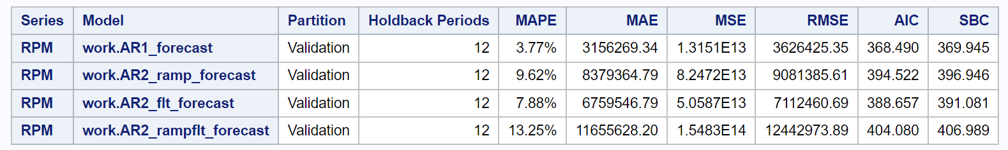
Model Comparison
To find the better model we look at following metrics,
For model accuracy- MAPE and MSE
For Parsimoniousness- AIC and SBC
If we look at the following results:
ARIMA(1,1) Model is the best model with, MAPE - 96.23% and MSE - 1.315
AIC - 368.490 and SBC - 369.945
Notes:
Shubham

Slide 9
Forecast Insights
Parameters | Pre Pandemic Data (Oct 2018 - Sept 2019) | 1 Year Previous Data (Oct 2022 - Sept 2023) | RAMP Forecasted Data (Oct 2023 - Sept 2024) | Forecasted Data (Oct 2024 - Sept 2025)
Total Forecasted Revenue Passenger Miles (RPM) | 1,043,159,551 Miles | 1,052,851,272 Miles | 1,134,606,681 Miles | 1,179,697,381 Miles
Growth Rate | 4.37% | 4.40% | 7.77% | 3.0 - 4.5%
Month with Highest RPM | July 2019 | July 2023 | July 2024 | July 2025
Month with Lowest RPM | February 2019 | February 2023 | February 2024 | February 2025
Notes:
Shubham

Slide 10
Recommended Business Actions
The aviation industry has nearly recovered from pandemic and is forecasted to continue growth similar to pre-pandemic
Airports:
Should continue on any cancelled / deferred pre-pandemic expansion or renovation plans
Continue to grow workforce, in particular highly skilled bottleneck positions
Airlines:
Continue any fleet expansion / upgrade plans to ensure sufficient capacity
Make sure to have budget available
Place any airplane orders sooner than pre-pandemic as supply chain is also recovering from pandemic
Keep forecasted growth in mind for ticket pricing strategy
Notes:
Balaji

Slide 11
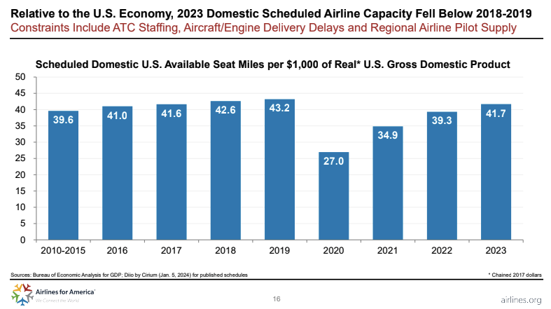
Importance of Forecast Models in Aviation Planning
The need for forecast models is real
According to airlines.org, U.S. domestic airline capacity was constrained by three factors in 2023:
Air traffic controller staffing
Aircraft/Engine Delivery Delays
Regional Airline Pilot Supply
Notes:
Kevin

Slide 12
Appendix Slides

Slide 13
Project Overview
Review data set for quality
Conduct descriptive assessment and correct any data issues
Conduct Time Series Exploration
Create model based on the tools learned in class and forecast key variables
Collect and assess insights
Collect any customer feedback
Document findings in report
Present findings to stakeholders

Slide 14
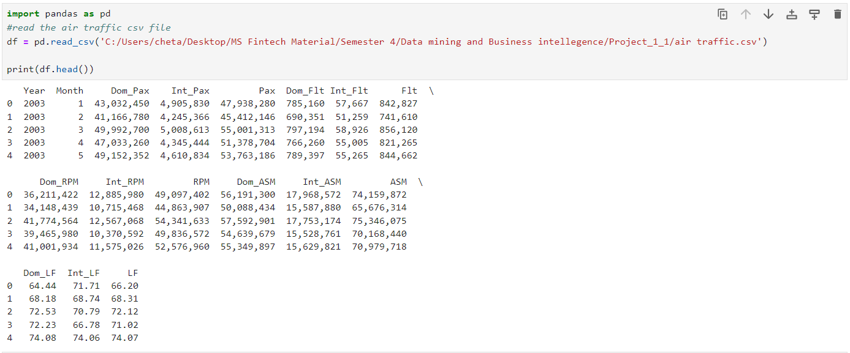
Data Cleaning in Python
Python data file read in:

Slide 15
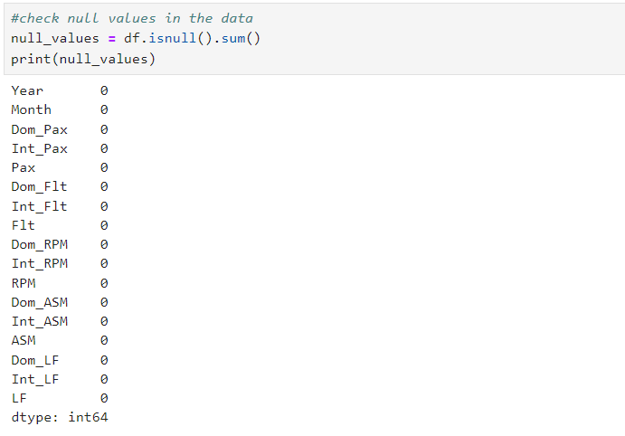
Data Cleaning in Python cont.
Null Value Checks:

Slide 16
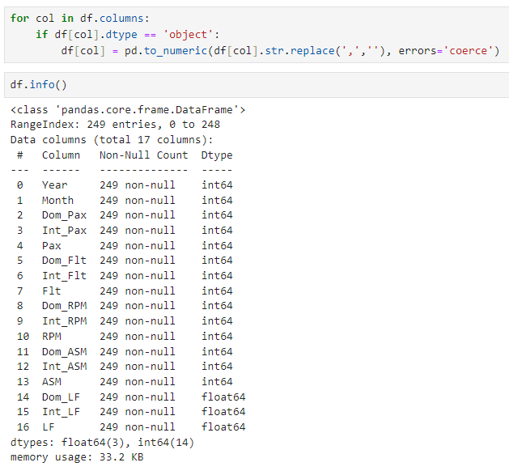
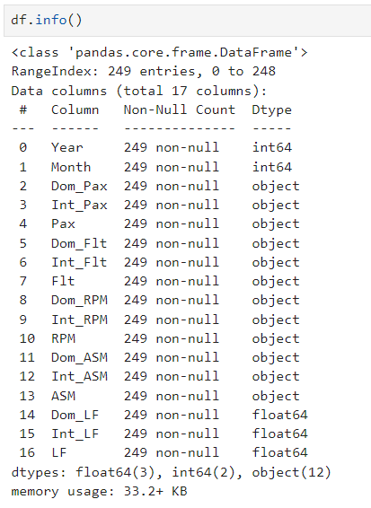
Data Cleaning in Python cont.
Data Type Corrections:
Summary:
Checked the data types:
Numeric values and object types due to the presence of comma (,) in values in the csv file.
Need to change these values into numeric to import it sas for forecasting.
Changed data type to numeric in Python

Slide 17
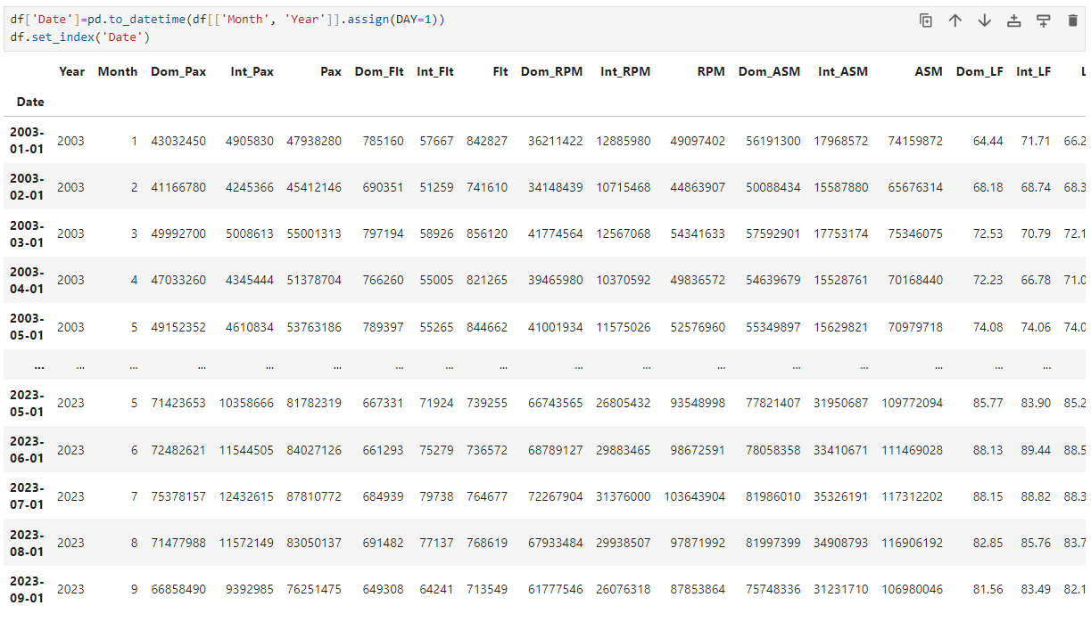
Data Cleaning in Python cont.
Date and Time Formatting:
Summary:
We have two variables ‘Year’ and ‘Month’, in order to use the data in SAS we need datetime format variables.
Combined ‘Year’ and ‘Month’ to create a new variable ‘Date’ which is a supported date format by SAS.

Slide 18




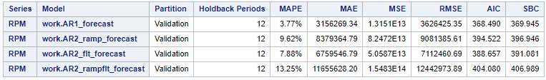
Accuracy and Fit
Considering all metrics, the "AR1_forecast" is the best model to use among those presented. It has the lowest error rates across all metrics, suggesting it has the best fit, highest accuracy, and is the most reliable for forecasting in this context
Notes:
Chetan

